Slide 1

Amazon API Gateway

Slide 2
What is Amazon API Gateway?
Amazon API Gateway is a fully managed service that makes it easy for developers to create, publish, maintain, monitor, and secure APIs at any scale. APIs act as the "front door" for applications to access data, business logic, or functionality from your backend services. Using API Gateway, you can create RESTful APIs and WebSocket APIs that enable real-time two-way communication applications. API Gateway supports containerized and serverless workloads, as well as web applications.

Slide 3
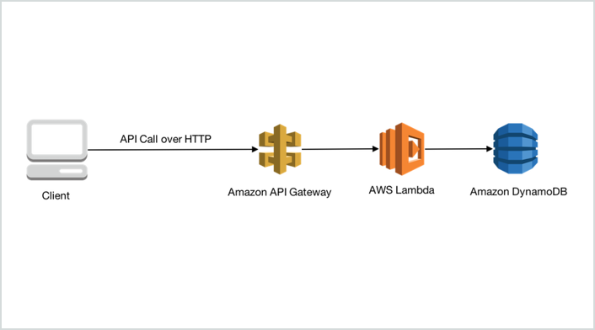

Slide 4
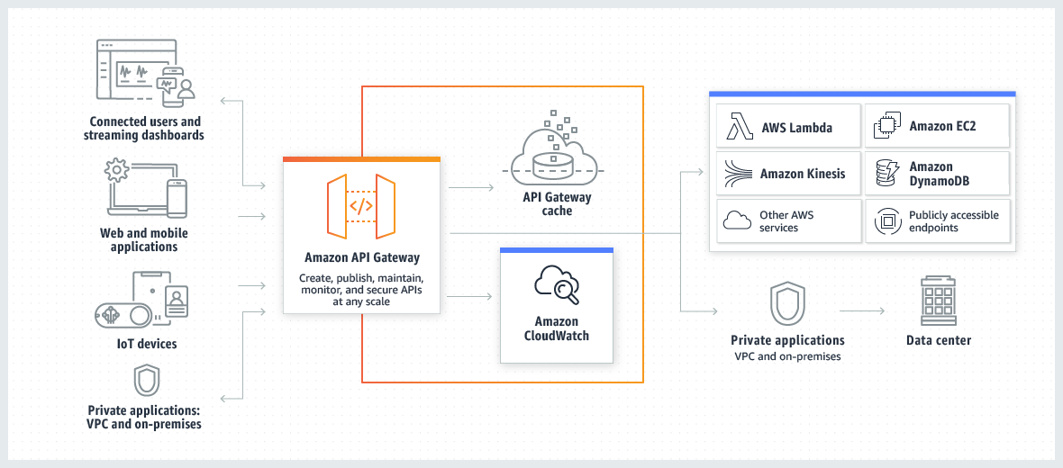

Slide 5
Features
Easy API Creation and Deployment
Resiliency
API Operations Monitoring
AWS Authorization
API Keys for Third-Party Developers
API Lifecycle Management

Slide 6
Benefits
Efficient API development
Performance at any scale
Cost savings at scale
Easy monitoring
Flexible security controls

Slide 7
Amazon API Gateway pricing
With Amazon API Gateway, you only pay when your APIs are in use. There are no minimum fees or upfront commitments. For HTTP APIs and REST APIs, you pay only for the API calls you receive, and the amount of data transferred out. There are no data transfer out charges for Private APIs.
The API Gateway free tier includes one million HTTP API calls, one million REST API calls, one million messages, and 750,000 connection minutes per month for up to 12 months.

Slide 8
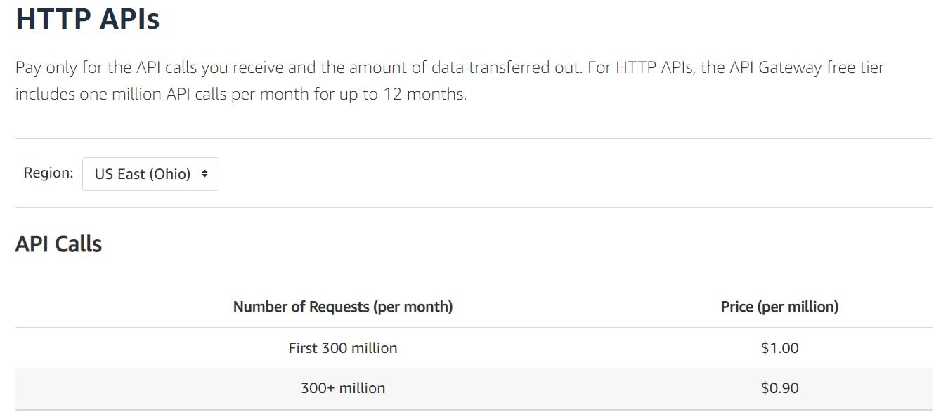

Slide 9
